Slide 1
Chapter 5: CPU Scheduling

Slide 2
Outline
Basic Concepts
Scheduling Criteria
Scheduling Algorithms
Thread Scheduling
Multi-Processor Scheduling
Real-Time CPU Scheduling
Operating Systems Examples
Algorithm Evaluation

Slide 3
Objectives
Describe various CPU scheduling algorithms
Assess CPU scheduling algorithms based on scheduling criteria
Explain the issues related to multiprocessor and multicore scheduling
Describe various real-time scheduling algorithms
Describe the scheduling algorithms used in the Windows, Linux, and Solaris operating systems
Apply modeling and simulations to evaluate CPU scheduling algorithms

Slide 4
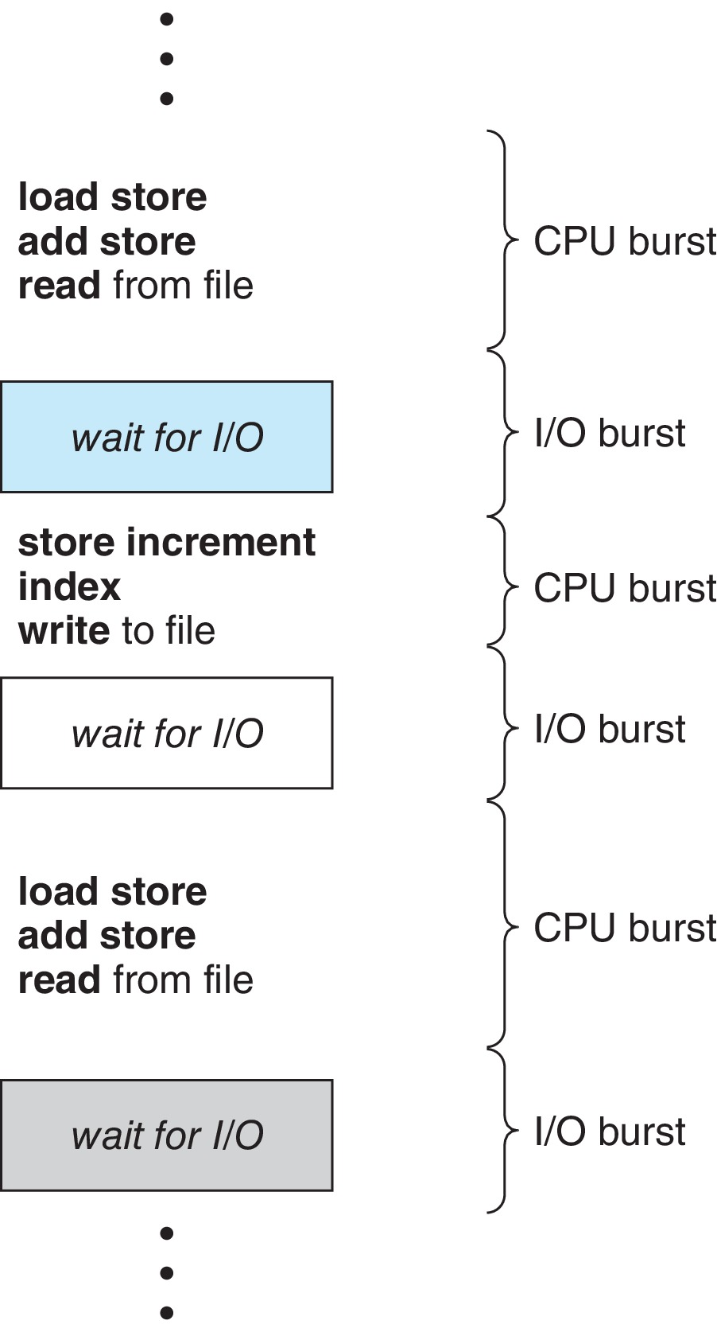
Basic Concepts
Maximum CPU utilization obtained with multiprogramming
CPU–I/O Burst Cycle – Process execution consists of a cycle of CPU execution and I/O wait
CPU burst followed by I/O burst
CPU burst distribution is of main concern

Slide 5
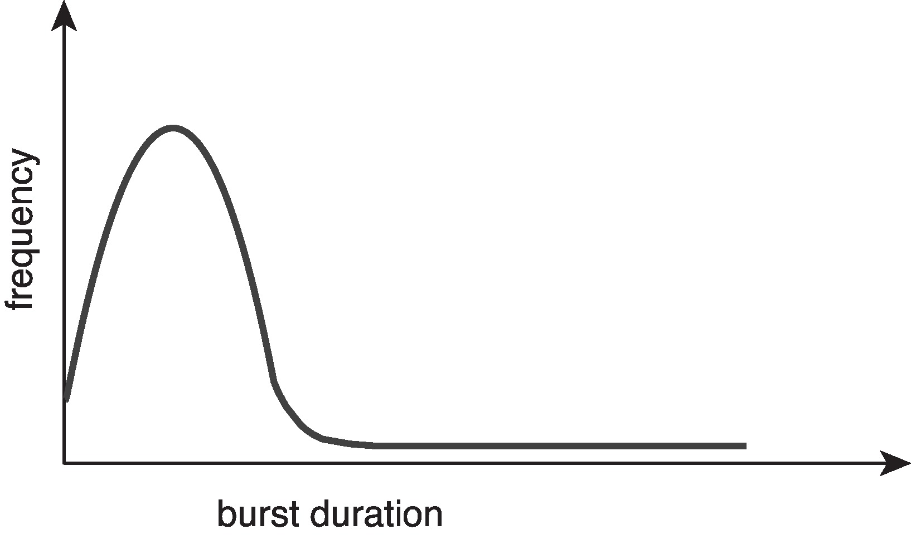
Histogram of CPU-burst Times
Large number of short bursts
Small number of longer bursts

Slide 6
CPU Scheduler
The CPU scheduler selects from among the processes in ready queue, and allocates a CPU core to one of them
Queue may be ordered in various ways
CPU scheduling decisions may take place when a process:
1. Switches from running to waiting state
2. Switches from running to ready state
3. Switches from waiting to ready
Terminates
For situations 1 and 4, there is no choice in terms of scheduling. A new process (if one exists in the ready queue) must be selected for execution.
For situations 2 and 3, however, there is a choice.

Slide 7
Preemptive and Nonpreemptive Scheduling
When scheduling takes place only under circumstances 1 and 4, the scheduling scheme is nonpreemptive.
Otherwise, it is preemptive.
Under Nonpreemptive scheduling, once the CPU has been allocated to a process, the process keeps the CPU until it releases it either by terminating or by switching to the waiting state.
Virtually all modern operating systems including Windows, MacOS, Linux, and UNIX use preemptive scheduling algorithms.

Slide 8
Preemptive Scheduling and Race Conditions
Preemptive scheduling can result in race conditions when data are shared among several processes.
Consider the case of two processes that share data. While one process is updating the data, it is preempted so that the second process can run. The second process then tries to read the data, which are in an inconsistent state.
This issue will be explored in detail in Chapter 6.

Slide 9
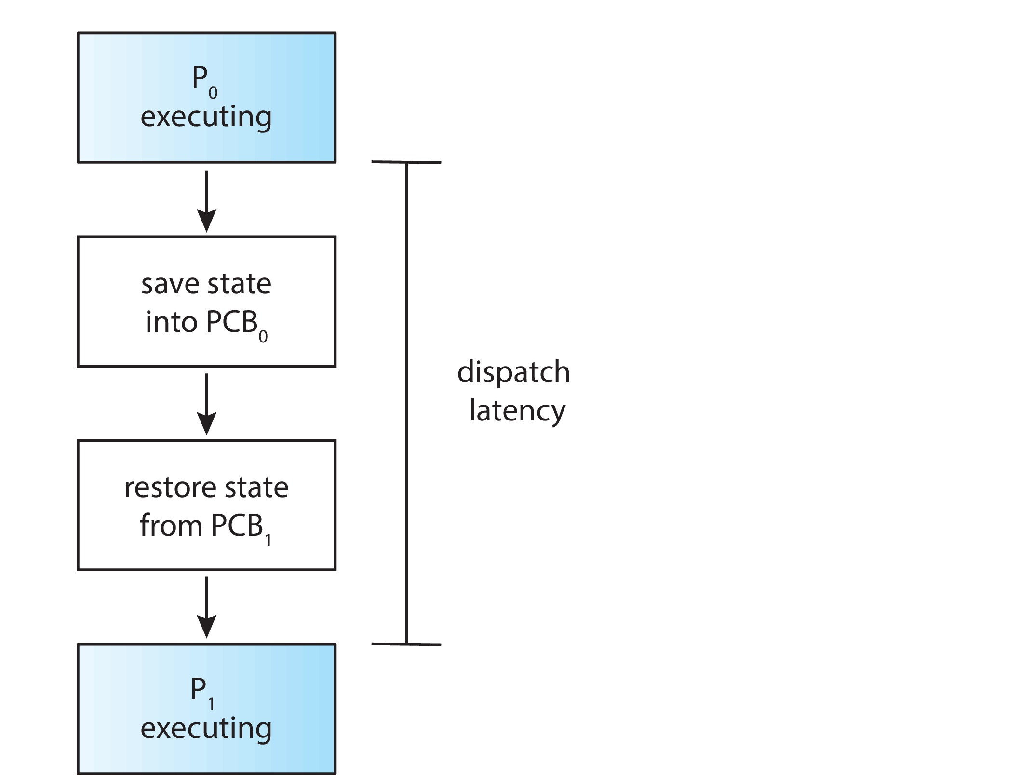
Dispatcher
Dispatcher module gives control of the CPU to the process selected by the CPU scheduler; this involves:
Switching context
Switching to user mode
Jumping to the proper location in the user program to restart that program
Dispatch latency – time it takes for the dispatcher to stop one process and start another running

Slide 10
Scheduling Criteria
CPU utilization – keep the CPU as busy as possible
Throughput – # of processes that complete their execution per time unit
Turnaround time – amount of time to execute a particular process
Waiting time – amount of time a process has been waiting in the ready queue
Response time – amount of time it takes from when a request was submitted until the first response is produced.

Slide 11
Scheduling Algorithm Optimization Criteria
Max CPU utilization
Max throughput
Min turnaround time
Min waiting time
Min response time

Slide 12
CPU scheduling Algorithms
First come, First serve.
Round Robin Scheduling.
Shortest Job First.
Shortest remaining time first.
Priority scheduling.
Multilevel queue scheduling.
Multilevel feedback queues scheduling.

Slide 13
Modes in CPU Scheduling Algorithms
There are two modes in CPU Scheduling Algorithms. They are:
Pre-emptive Approach
Non Pre-emptive Approach
In Pre Emptive-Approach the process once starts its execution then the CPU is allotted to the same process until the completion of process. There would be no shift of Processes by the Central Processing Unit. The complete CPU is allocated to the Process and there would be no change of CPU allocation until the process is complete.
In Non-Pre Emptive-Approach the process once stars its execution, then the CPU is not allotted to the same process until the completion of process. There is a shift of Processes by the Central Processing Unit. The complete CPU is allocated to the Process when only certain required conditions are achieved and there will be change of CPU allocation if there is break or False occurrence in the required conditions.

Slide 14
First- Come, First-Served (FCFS) Scheduling
Process Burst Time(ms)
P₁ 24
P₂ 3
P₃ 3
Suppose that the processes arrive in the order: P₁ , P₂ , P₃ The Gantt Chart for the schedule is:
Waiting time for P₁ = 0; P₂ = 24; P₃ = 27 ms
Average waiting time: (0 + 24 + 27)/3 = 17 ms
TAT: (24+27+30) =81ms
ATAT: (24+27+30)/3 = 27 ms

Slide 15
Turnaround time:
Turnaround time refers to the time interval from the time of submission of a process towards the time of the finishing of the process. Turnaround time can also be considered the addition of the time periods spent waiting to get into memory or ready queue and execution on CPU .
Turnaround time (TAT) is defined as the total time interval between the time of process submission and the time of its completion. The significant difference between the time of completion and the time of arrival is named the turnaround time of the process.
CT (Completion Time) – Completion time is the exact time when a process finishes the execution.
AT (Arrival Time) – Arrival time is called as the time of arrival of a process before the state of preparedness (before its execution).
Therefore, TAT = CT-AT. , or TAT=BT+WT

Slide 16
Waiting time (WT)
Waiting time (WT) is defined as the total time that is spent by the process while staying in a ready queue before it reaches the CPU. Thus, waiting time = arrival time-scheduling time or =TAT-BT
BT (Burst Time) – Burst time is the total time that is required by a process for its execution, CPU burst.

Slide 17
Turn Around Time | Waiting Time
The time since the process entered into ready queue for execution till the process completed it’s execution. | The time process spent in the ready queue and for I/O completion.
Different CPU Scheduling algorithms produce different TAT for the same set of processes. | CPU Scheduling Algorithm doesn’t affect the amount of time during which a process executes or does I/O but only the amount of time that a process spends waiting in the ready queue.
The turnaround time is generally limited by the speed of the output device. | Waiting time has no such major effect.
Turn Around Time = Burst time + Waiting time. | Waiting time = Turn Around – Burst time.

Slide 18
FCFS Scheduling (Cont.)
Suppose that the processes arrive in the order:
P₂ , P₃ , P₁
The Gantt chart for the schedule is:
Waiting time for P₁ = 6; P₂ = 0; P₃ = 3
Average waiting time: (6 + 0 + 3)/3 = 3
Much better than previous case
Convoy effect - short process behind long process
To avoid Consider one CPU-bound and many I/O-bound processes

Slide 19
Process | Arrival time(AT) | CPU Burst( Execution time)
p0 | 0 | 5
p1 | 1 | 3
p2 | 2 | 8
p3 | 3 | 9
p0 | p1 | p2 | p3
0 5 | 8 | 16 | 25

Slide 20
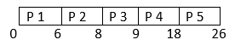
Process ID | Arrival Time | Burst Time | Completion Time | Turn Around Time | Waiting Time
P 1 | 0 | 6 | 6 | 6 | 0
P 2 | 2 | 2 | 8 | 6 | 4
P 3 | 3 | 1 | 9 | 7 | 5
P4 | 4 | 9 | 18 | 14 | 5
P 5 | 5 | 8 | 26 | 21 | 13
AWT?
ATAT?

Slide 21
Shortest-Job-First (SJF) Scheduling
Associate with each process the length of its next CPU burst
Use these lengths to schedule the process with the shortest time
SJF is optimal – gives minimum average waiting time for a given set of processes
The difficulty is knowing the length of the next CPU request
Could ask the user

Slide 22
Shortest-Job-First (SJF) Scheduling
Associate with each process the length of its next CPU burst
Use these lengths to schedule the process with the shortest time
SJF is optimal – gives minimum average waiting time for a given set of processes
Preemptive version called shortest-remaining-time-first
How do we determine the length of the next CPU burst?
Could ask the user
Estimate

Slide 23
Example of SJF
ProcessArriva l Time Burst Time (ms)
P₁ 0.0 6
P₂ 2.0 8
P₃ 4.0 7
P₄ 5.0 3
SJF scheduling chart
Average waiting time = (3 + 16 + 9 + 0) / 4 = 7 ms
ATAT = (9+24+16+3)/4 = 52/4=13 ms

Slide 24
Process | Arrival time(AT) | CPU Burst( Execution time)
p0 | 0 | 5
p1 | 4 | 3
p2 | 8 | 8
p3 | 4 | 9

Slide 25
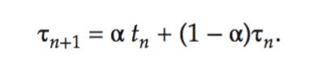
Determining Length of Next CPU Burst
Can only estimate the length – should be similar to the previous one
Then pick process with shortest predicted next CPU burst
Can be done by using the length of previous CPU bursts, using exponential averaging
Commonly, α set to ½

Slide 26
Example of Shortest-remaining-time-first
Now we add the concepts of varying arrival times and preemption to the analysis
ProcessA arri Arrival TimeT Burst Time
P₁ 0 8
P₂ 1 4
P₃ 2 9
P₄ 3 5
Preemptive SJF Gantt Chart
Average waiting time = [(10-1)+(1-1)+(17-2)+(5-3)]/4 = 26/4 = 6.5

Slide 27
Round-Robin Scheduling Algorithm
Round-Robin is a Preemptive Scheduling Algorithm and is the most commonly used algorithm in CPU Scheduling. In this, each Process is assigned with a fix time interval to execute, which is called quantum. In the round-robin, the Process gets preempted if it is executed in the given time period, and the rest of the Processes executes accordingly. Round robin is a starvation free CPU scheduling algorithm as all the Processes get fair sharing of CPU. Round-Robin is a Preemptive version of the first-come-first-serve scheduling. Time-sharing is the objective of this algorithm. In the round-robin algorithm, each Process is cyclically executed.

Slide 28
Round Robin (RR)
Each process gets a small unit of CPU time (time quantum q), usually 10-100 milliseconds. After this time has elapsed, the process is preempted and added to the end of the ready queue.
If there are n processes in the ready queue and the time quantum is q, then each process gets 1/n of the CPU time in chunks of at most q time units at once. No process waits more than (n-1)q time units.
Timer interrupts every quantum to schedule next process
Performance
q large ⇒ FIFO
q small ⇒ q must be large with respect to context switch, otherwise overhead is too high

Slide 29
Example of RR with Time Quantum = 4
Process Burst Time
P₁ 24
P₂ 3
P₃ 3
The Gantt chart is:
Typically, higher average turnaround than SJF, but better response
q should be large compared to context switch time
q usually 10 milliseconds to 100 milliseconds,
Context switch < 10 microseconds

Slide 30
Process ID | Arriving Time | Burst Time
P1 | 0 | 8
P2 | 1 | 5
P3 | 2 | 10
P4 | 3 | 11

Slide 31
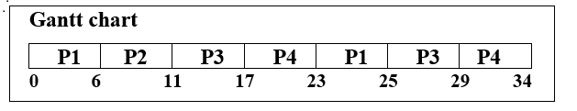
Process ID | Arriving Time | Burst Time | Completion Time | Turnaround Time | Waiting Time
P1 | 0 | 8 | 25 | 25 | 17
P2 | 1 | 5 | 11 | 10 | 5
P3 | 2 | 10 | 29 | 27 | 17
P4 | 3 | 11 | 34 | 31 | 20

Slide 32
Steps for Gantt Chart
Step 1. In the above Gantt chart, firstly the Process P1 starts its execution, which has burst time = 8. But each process is executing only for 6 seconds because quantum time is 6. The process P2, P3, and P4 are in the waiting queue.
Step 2. At time=6, the process P1 is added to the end of the queue, and the process P2 starts its execution.
Step 3. At time=11, the process P2, which has the burst time=5, completes its execution in the given time of quantum.
Step 4. After P2, the process P3 starts its execution, which has burst time=10, but again it is also executed for 6 seconds due to the limit of quantum time. At time=17, the process P3 is added to the end of the queue.
Step 5. After P3, the next process P4 starts its execution, the burst time of P4 is 11, but it also executes for only 6 seconds.
Step 6. After P4, the process P1 again starts its execution because P1 Process left its execution due to less quantum time. So, process P1 again starts its execution to complete its execution.
Step 7. At time=29, P3 completes its execution, and P4 starts its execution again. The burst time of P4 is 11, and it is also executed for 6 intervals. At time=34, the process P4 completes its execution.
The waiting time and Turnaround time are calculated with the help of the following formula.
Waiting Time = Turnaround time – Burst Time
Turnaround Time = Completion time – Arrival time

Slide 33
Process Turnaround Time
P1= 25-0 =0
P2= 11-1=10
P3= 29-2 = 27
P4= 34-3=31
Average Turnaround Time= 0+10+27+31/4
= 68/4
=17
Process Waiting Time
P1= 25-8=17
P2=10-5=5
P3=27-10=17
P4=31-11=20
Average Waiting Time = 17+5+17+20/4
=59/4
=14.75

Slide 34
Advantages of the Round-Robin Scheduling Algorithm
The advantages of the round-robin scheduling algorithm are:
Round-Robin is independent of starvation or convoy effect.
In Round-Robin, every process gets a fair allocation of CPU.
If the number of processes present in the running queue is known, then it becomes easy to estimate the worst-case response time of the process.
Handles all the processes without priority.
Round-Robin is easy to implement.

Slide 35
Disadvantages of Round-Robin Scheduling Algorithm
The disadvantages of the round-robin scheduling algorithm are:
Average Waiting Time is Higher.
It depends on the length of the time slice.
If the time quantum is more than the response time is also more.
If the time quantum is less than the context switching overhead is more.

Slide 36
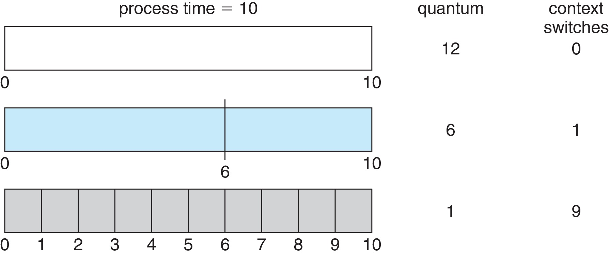
Time Quantum and Context Switch Time

Slide 37
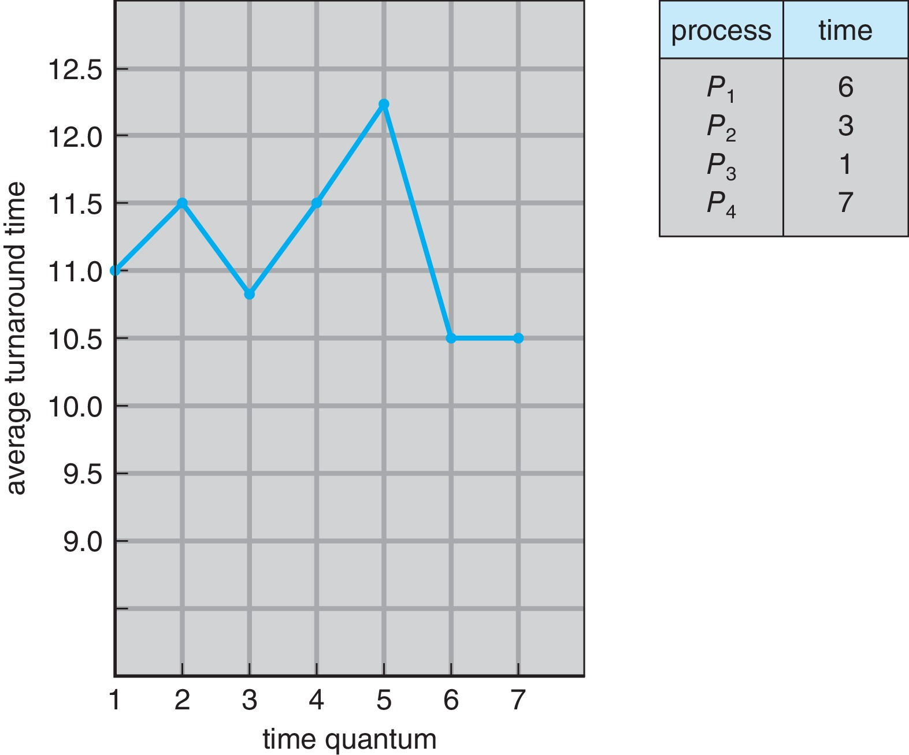
Turnaround Time Varies With The Time Quantum
80% of CPU bursts should be shorter than q

Slide 38
Priority Scheduling
A priority number (integer) is associated with each process
The CPU is allocated to the process with the highest priority (smallest integer ≡ highest priority)
Preemptive
Nonpreemptive
SJF is priority scheduling where priority is the inverse of predicted next CPU burst time
Problem ≡ Starvation – low priority processes may never execute
Solution ≡ Aging – as time progresses increase the priority of the process

Slide 39
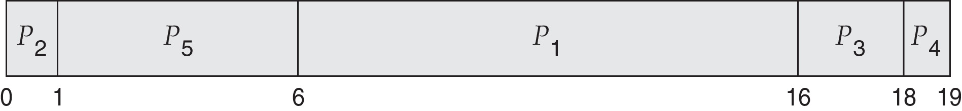
Example of Priority Scheduling
ProcessA arri Burst TimeT Priority
P₁ 10 3
P₂ 1 1
P₃ 2 4
P₄ 1 5
P₅ 5 2
Priority scheduling Gantt Chart
Average waiting time = 8.2

Slide 40
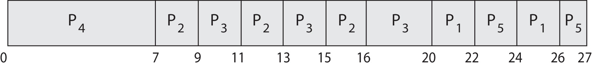
Priority Scheduling w/ Round-Robin
ProcessA arri Burst TimeT Priority
P₁ 4 3
P₂ 5 2
P₃ 8 2
P₄ 7 1
P₅ 3 3
Run the process with the highest priority. Processes with the same priority run round-robin
Gantt Chart with time quantum = 2

Slide 41
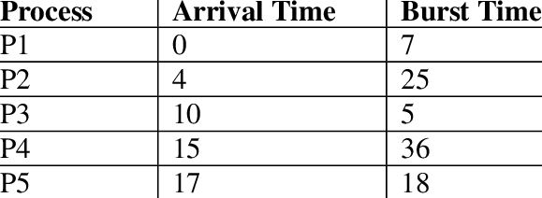
Solve this for FCFS, SJF, RR with time slice 4ms

Slide 42
Priority
4
2
1
3
5
Solve this for non-preemptive and preemptive priority scheduling

Slide 43
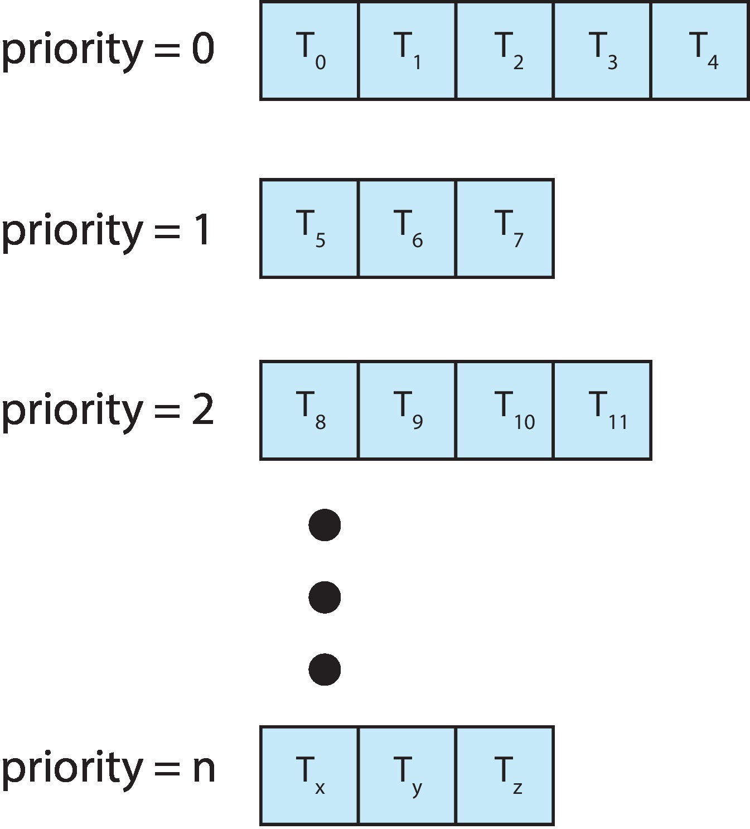
Multilevel Queue
With priority scheduling, have separate queues for each priority.
Schedule the process in the highest-priority queue!

Slide 44
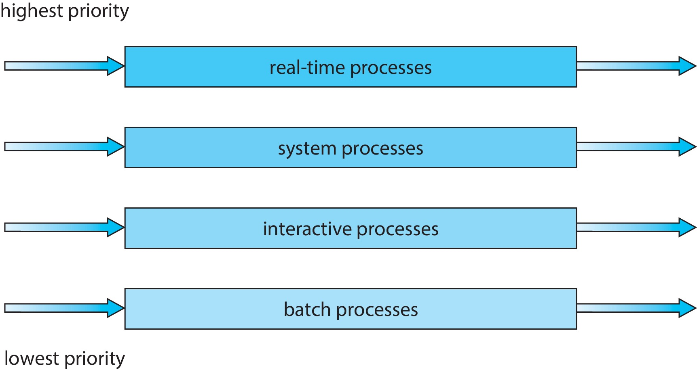
Multilevel Queue
Prioritization based upon process type

Slide 45
Multilevel Feedback Queue
A process can move between the various queues.
Multilevel-feedback-queue scheduler defined by the following parameters:
Number of queues
Scheduling algorithms for each queue
Method used to determine when to upgrade a process
Method used to determine when to demote a process
Method used to determine which queue a process will enter when that process needs service
Aging can be implemented using multilevel feedback queue

Slide 46
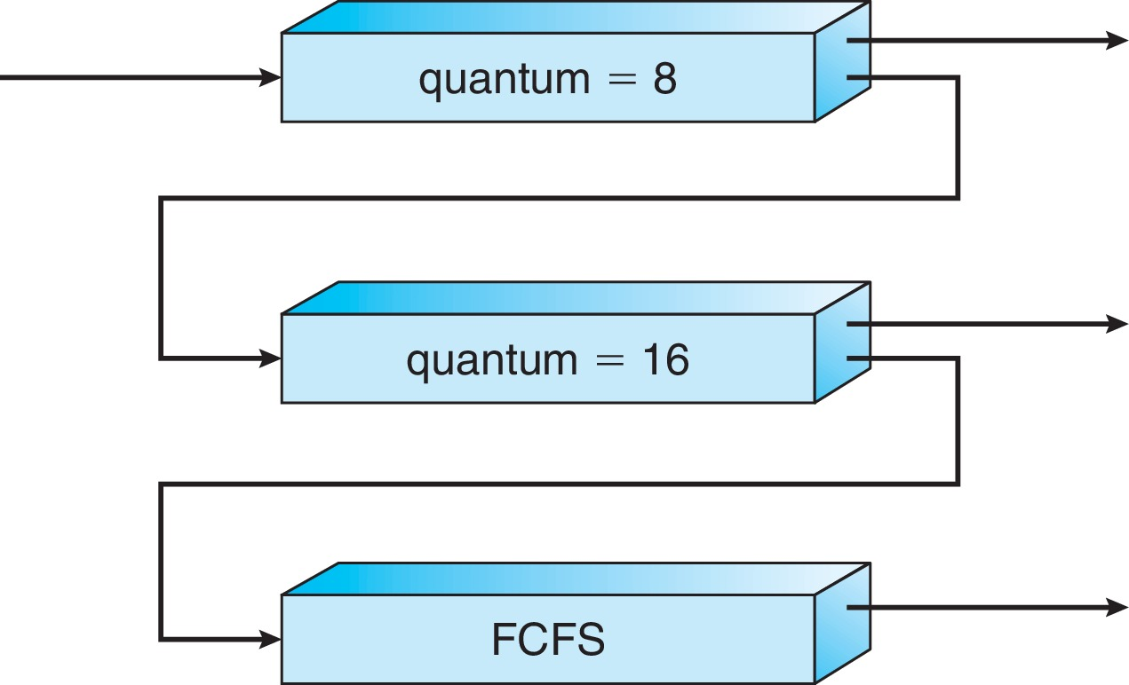
Example of Multilevel Feedback Queue
Three queues:
Q₀ – RR with time quantum 8 milliseconds
Q₁ – RR time quantum 16 milliseconds
Q₂ – FCFS
Scheduling
A new process enters queue Q₀ which is served in RR
When it gains CPU, the process receives 8 milliseconds
If it does not finish in 8 milliseconds, the process is moved to queue Q₁
At Q₁ job is again served in RR and receives 16 additional milliseconds
If it still does not complete, it is preempted and moved to queue Q₂

Slide 47
Thread Scheduling
Distinction between user-level and kernel-level threads
When threads supported, threads scheduled, not processes
Many-to-one and many-to-many models, thread library schedules user-level threads to run on LWP
Known as process-contention scope (PCS) since scheduling competition is within the process
Typically done via priority set by programmer
Kernel thread scheduled onto available CPU is system-contention scope (SCS) – competition among all threads in system

Slide 48
Pthread Scheduling
API allows specifying either PCS or SCS during thread creation
PTHREAD_SCOPE_PROCESS schedules threads using PCS scheduling
PTHREAD_SCOPE_SYSTEM schedules threads using SCS scheduling
Can be limited by OS – Linux and macOS only allow PTHREAD_SCOPE_SYSTEM

Slide 49
Pthread Scheduling API
#include <pthread.h>
#include <stdio.h>
#define NUM_THREADS 5
int main(int argc, char *argv[]) {
int i, scope; pthread_t tid[NUM THREADS];
pthread_attr_t attr;
/* get the default attributes */
pthread_attr_init(&attr);
/* first inquire on the current scope */ if (pthread_attr_getscope(&attr, &scope) != 0)
fprintf(stderr, "Unable to get scheduling scope\n");
else {
if (scope == PTHREAD_SCOPE_PROCESS)
printf("PTHREAD_SCOPE_PROCESS");
else if (scope == PTHREAD_SCOPE_SYSTEM)
printf("PTHREAD_SCOPE_SYSTEM");
else fprintf(stderr, "Illegal scope value.\n");
}

Slide 50
Pthread Scheduling API
/* set the scheduling algorithm to PCS or SCS */
pthread_attr_setscope(&attr, PTHREAD_SCOPE_SYSTEM);
/* create the threads */ for (i = 0; i < NUM_THREADS; i++)
pthread_create(&tid[i],&attr,runner,NULL);
/* now join on each thread */ for (i = 0; i < NUM_THREADS; i++)
pthread_join(tid[i], NULL);
}
/* Each thread will begin control in this function */
void *runner(void *param) {
/* do some work ... */
pthread_exit(0);
}

Slide 51
Multiple-Processor Scheduling
CPU scheduling more complex when multiple CPUs are available
Multiprocess may be any one of the following architectures:
Multicore CPUs
Multithreaded cores
NUMA systems
Heterogeneous multiprocessing

Slide 52
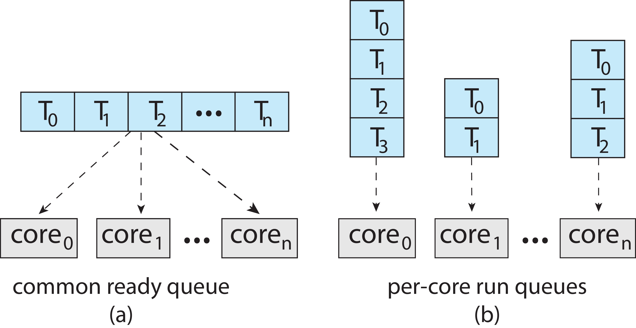
Multiple-Processor Scheduling
Symmetric multiprocessing (SMP) is where each processor is self scheduling.
All threads may be in a common ready queue (a)
Each processor may have its own private queue of threads (b)

Slide 53
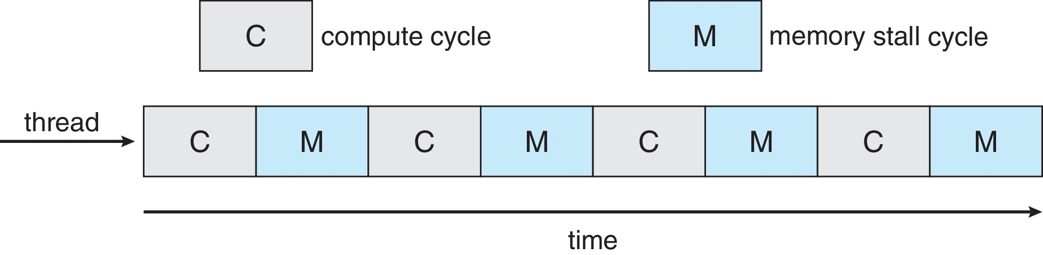
Multicore Processors
Recent trend to place multiple processor cores on same physical chip
Faster and consumes less power
Multiple threads per core also growing
Takes advantage of memory stall to make progress on another thread while memory retrieve happens
Figure

Slide 54
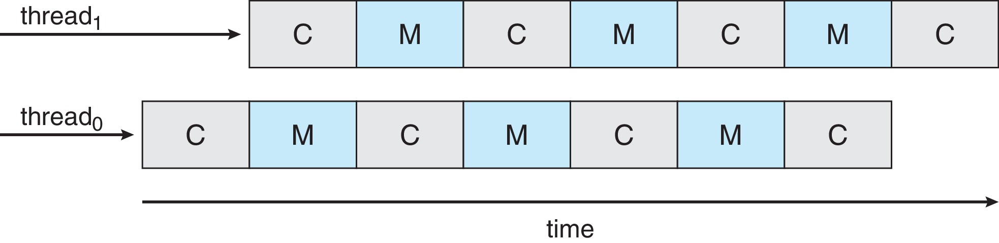
Multithreaded Multicore System
Each core has > 1 hardware threads.
If one thread has a memory stall, switch to another thread!
Figure

Slide 55
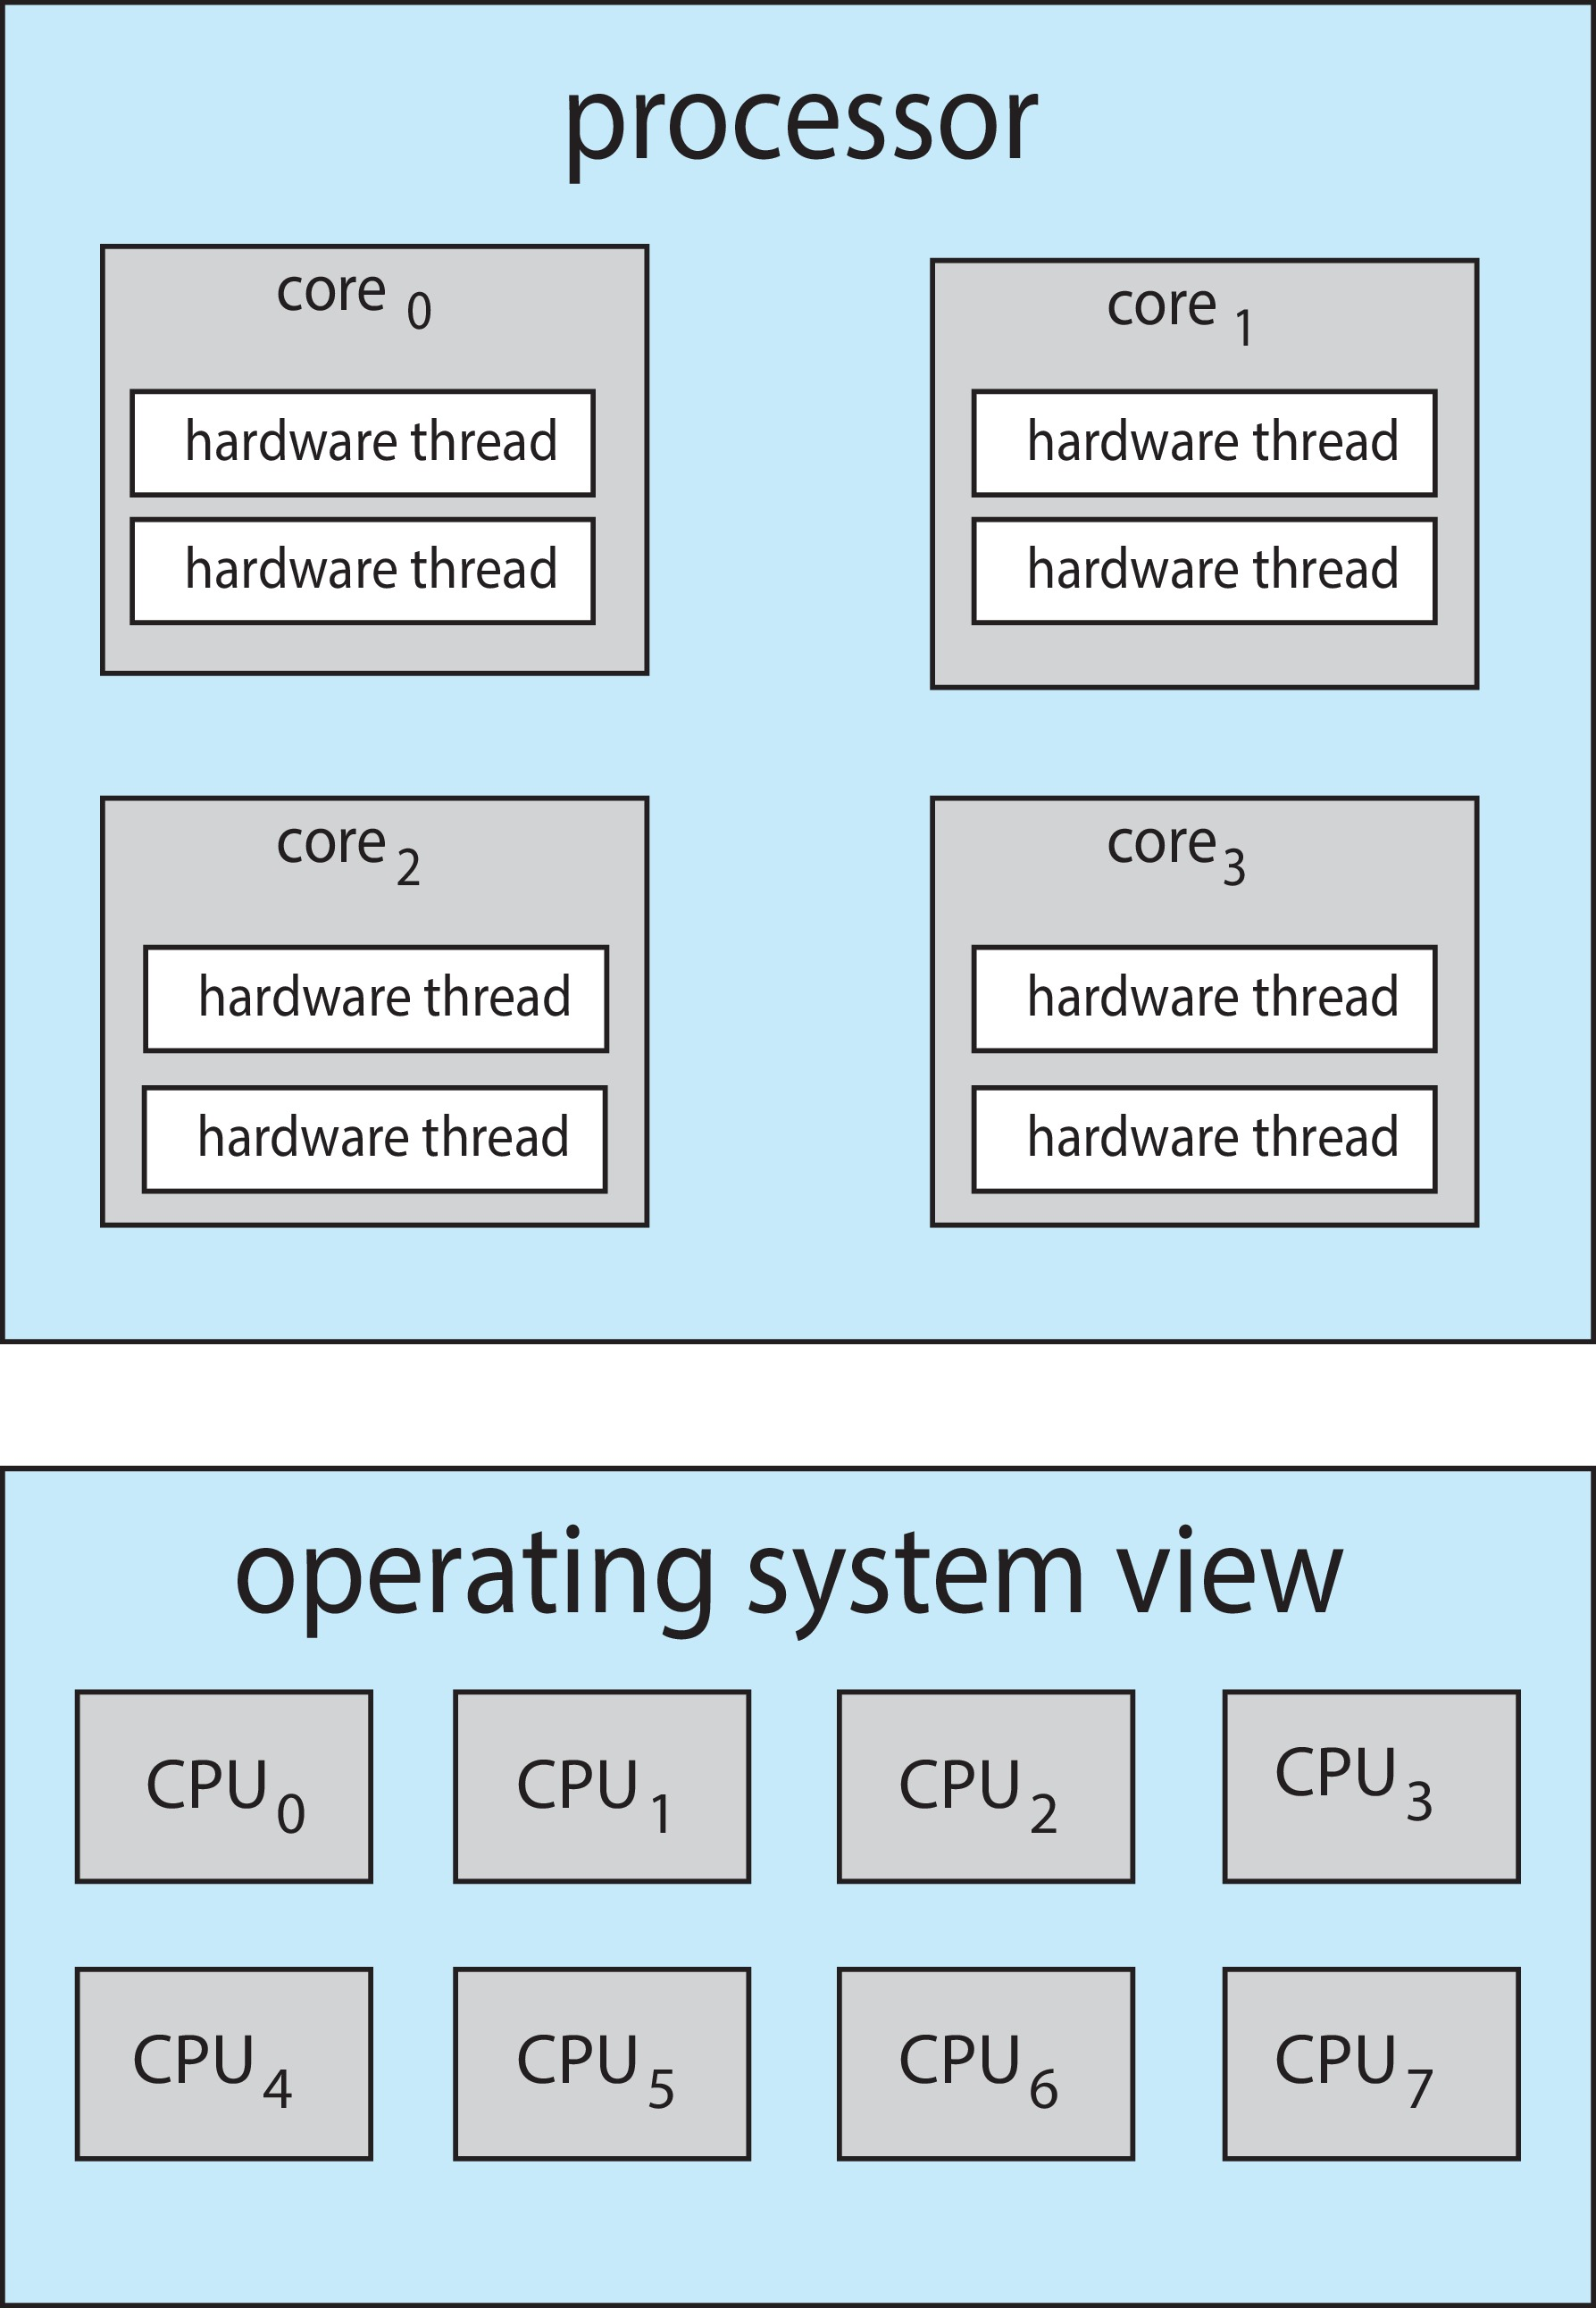
Multithreaded Multicore System
Chip-multithreading (CMT) assigns each core multiple hardware threads. (Intel refers to this as hyperthreading.)
On a quad-core system with 2 hardware threads per core, the operating system sees 8 logical processors.

Slide 56
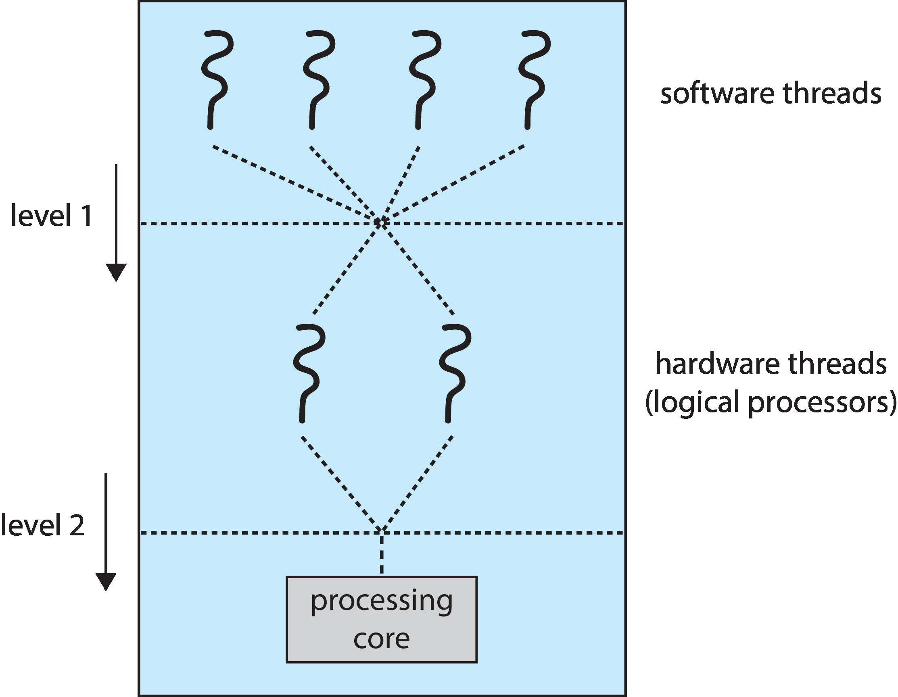
Multithreaded Multicore System
Two levels of scheduling:
The operating system deciding which software thread to run on a logical CPU
How each core decides which hardware thread to run on the physical core.

Slide 57
Multiple-Processor Scheduling – Load Balancing
If SMP, need to keep all CPUs loaded for efficiency
Load balancing attempts to keep workload evenly distributed
Push migration – periodic task checks load on each processor, and if found pushes task from overloaded CPU to other CPUs
Pull migration – idle processors pulls waiting task from busy processor

Slide 58
Multiple-Processor Scheduling – Processor Affinity
When a thread has been running on one processor, the cache contents of that processor stores the memory accesses by that thread.
We refer to this as a thread having affinity for a processor (i.e., “processor affinity”)
Load balancing may affect processor affinity as a thread may be moved from one processor to another to balance loads, yet that thread loses the contents of what it had in the cache of the processor it was moved off of.
Soft affinity – the operating system attempts to keep a thread running on the same processor, but no guarantees.
Hard affinity – allows a process to specify a set of processors it may run on.

Slide 59
NUMA and CPU Scheduling
If the operating system is NUMA-aware, it will assign memory closes to the CPU the thread is running on.

Slide 60
Real-Time CPU Scheduling
Can present obvious challenges
Soft real-time systems – Critical real-time tasks have the highest priority, but no guarantee as to when tasks will be scheduled
Hard real-time systems – task must be serviced by its deadline

Slide 61
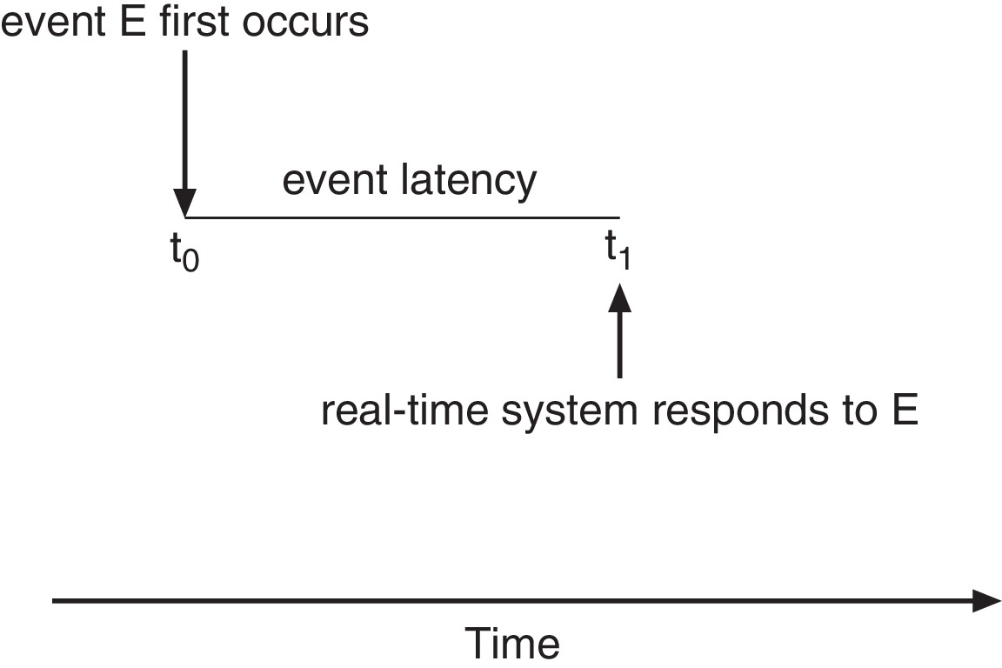
Real-Time CPU Scheduling
Event latency – the amount of time that elapses from when an event occurs to when it is serviced.
Two types of latencies affect performance
Interrupt latency – time from arrival of interrupt to start of routine that services interrupt
Dispatch latency – time for schedule to take current process off CPU and switch to another

Slide 62
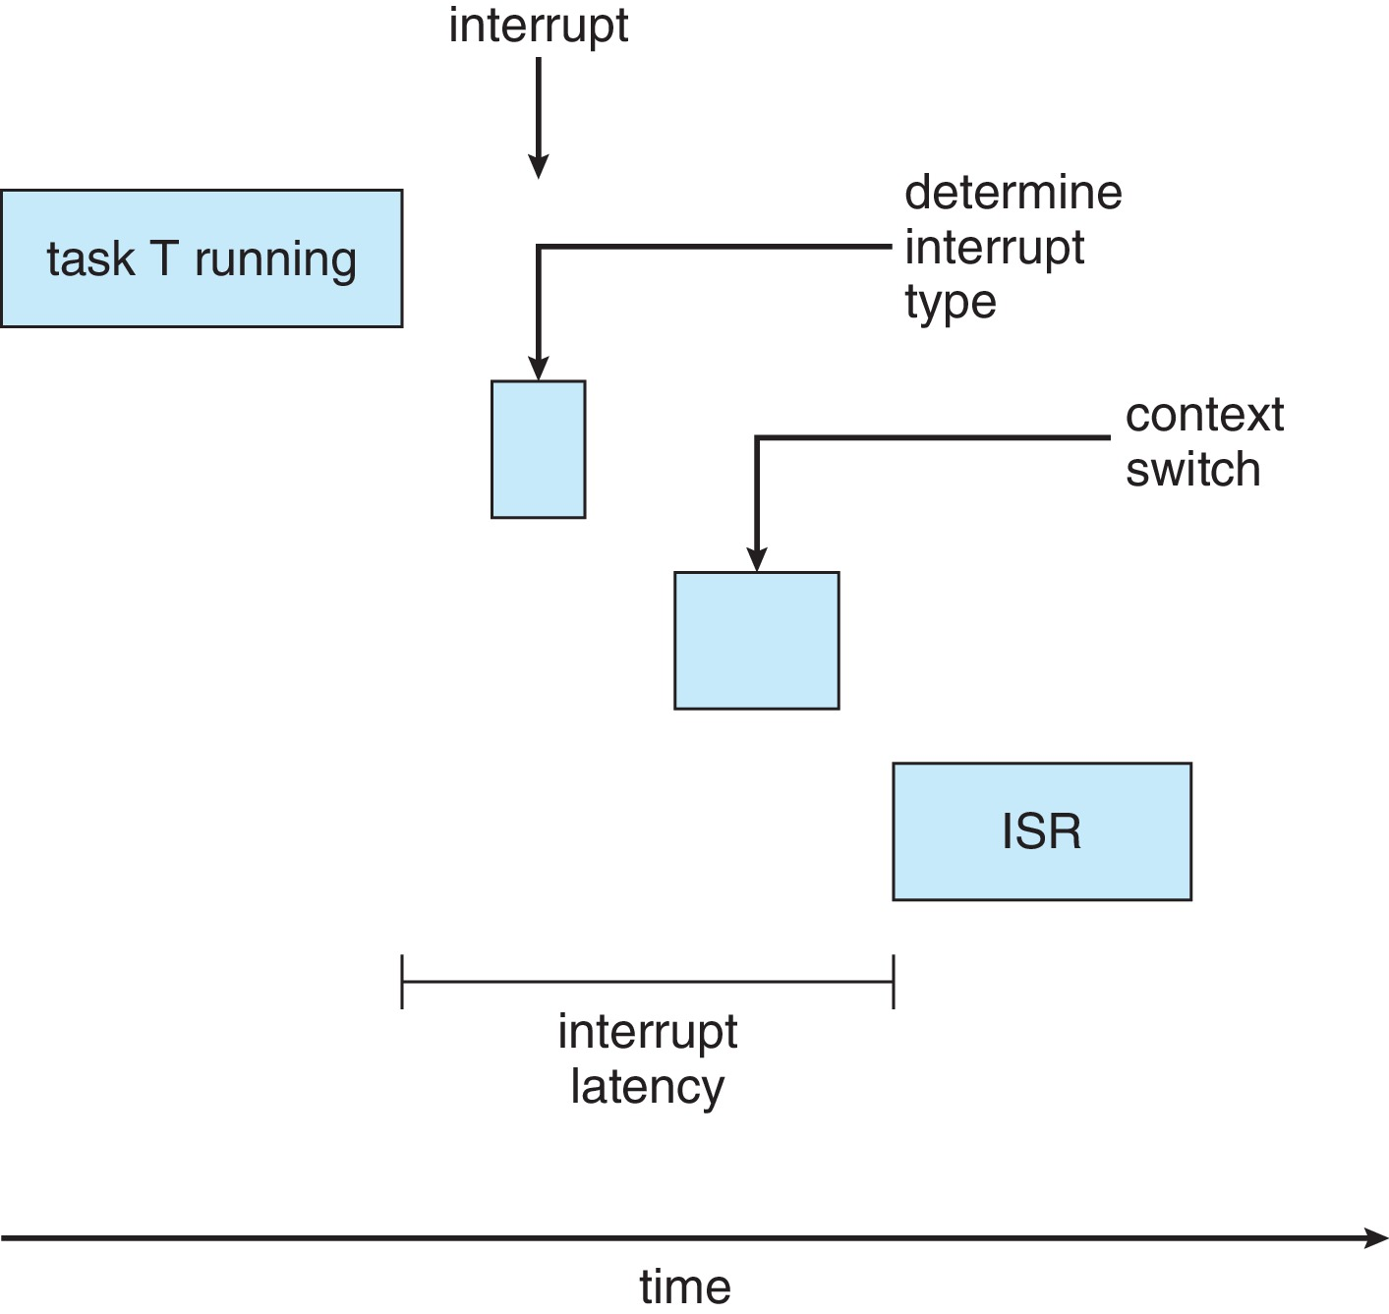
Interrupt Latency

Slide 63
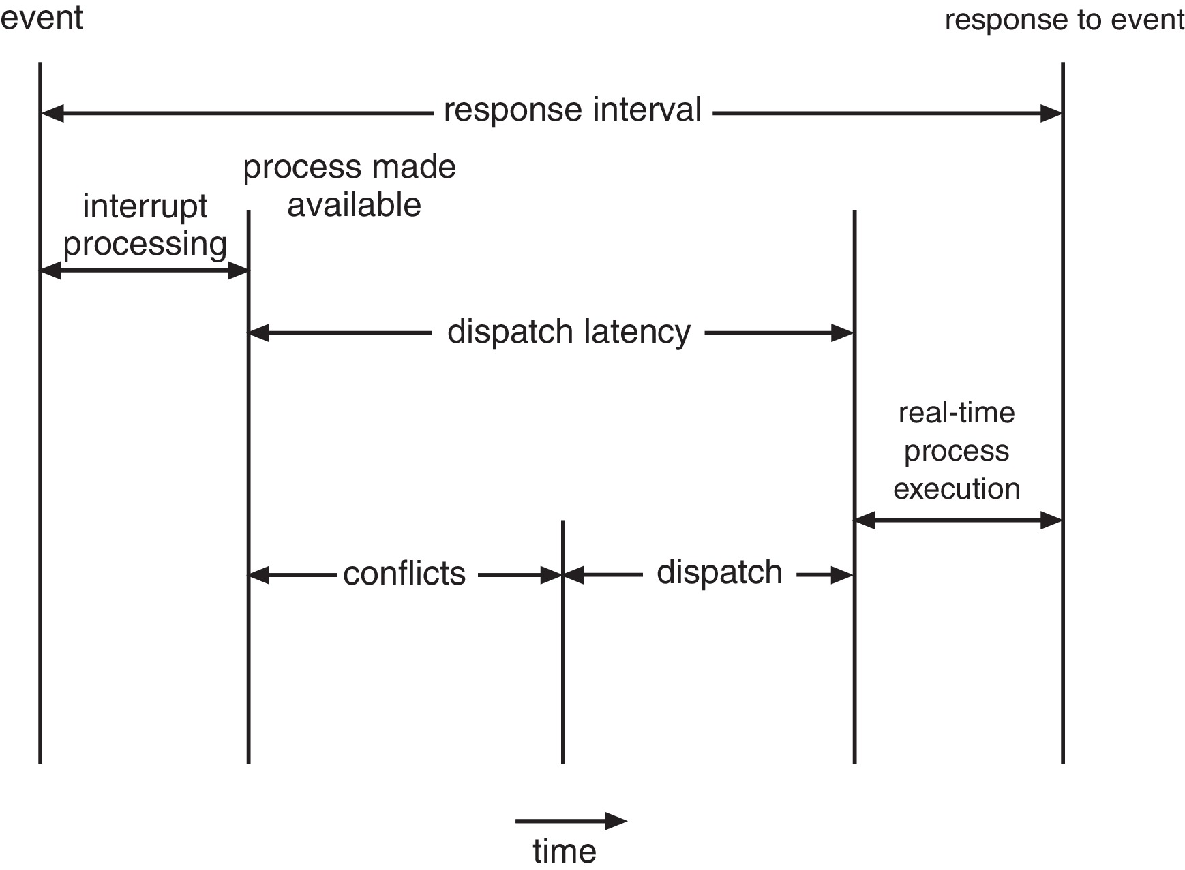
Dispatch Latency
Conflict phase of dispatch latency:
Preemption of any process running in kernel mode
Release by low-priority process of resources needed by high-priority processes

Slide 64
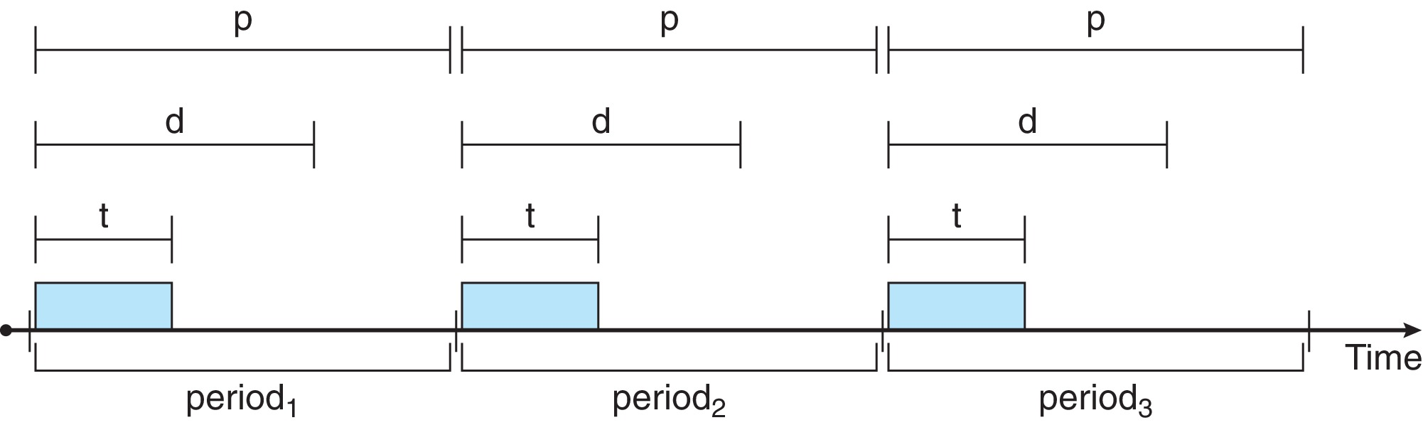
Priority-based Scheduling
For real-time scheduling, scheduler must support preemptive, priority-based scheduling
But only guarantees soft real-time
For hard real-time must also provide ability to meet deadlines
Processes have new characteristics: periodic ones require CPU at constant intervals
Has processing time t, deadline d, period p
0 ≤ t ≤ d ≤ p
Rate of periodic task is 1/p

Slide 65
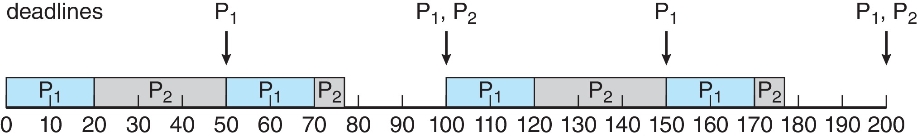
Rate Monotonic Scheduling
A priority is assigned based on the inverse of its period
Shorter periods = higher priority;
Longer periods = lower priority
P₁ is assigned a higher priority than P₂.

Slide 66
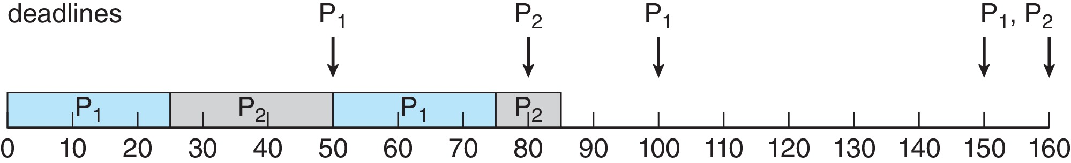
Missed Deadlines with Rate Monotonic Scheduling
Process P₂ misses finishing its deadline at time 80
Figure

Slide 67
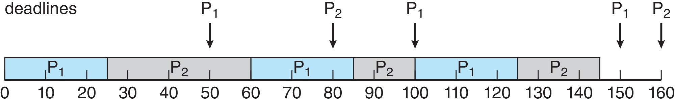
Earliest Deadline First Scheduling (EDF)
Priorities are assigned according to deadlines:
The earlier the deadline, the higher the priority
The later the deadline, the lower the priority
Figure

Slide 68
Proportional Share Scheduling
T shares are allocated among all processes in the system
An application receives N shares where N < T
This ensures each application will receive N / T of the total processor time

Slide 69
POSIX Real-Time Scheduling
The POSIX.1b standard
API provides functions for managing real-time threads
Defines two scheduling classes for real-time threads:
SCHED_FIFO - threads are scheduled using a FCFS strategy with a FIFO queue. There is no time-slicing for threads of equal priority
SCHED_RR - similar to SCHED_FIFO except time-slicing occurs for threads of equal priority
Defines two functions for getting and setting scheduling policy:
pthread_attr_getsched_policy(pthread_attr_t *attr, int *policy)
pthread_attr_setsched_policy(pthread_attr_t *attr, int policy)

Slide 70
POSIX Real-Time Scheduling API
#include <pthread.h>
#include <stdio.h>
#define NUM_THREADS 5
int main(int argc, char *argv[])
{
int i, policy; pthread_t_tid[NUM_THREADS];
pthread_attr_t attr;
/* get the default attributes */
pthread_attr_init(&attr);
/* get the current scheduling policy */ if (pthread_attr_getschedpolicy(&attr, &policy) != 0)
fprintf(stderr, "Unable to get policy.\n");
else {
if (policy == SCHED_OTHER) printf("SCHED_OTHER\n");
else if (policy == SCHED_RR) printf("SCHED_RR\n");
else if (policy == SCHED_FIFO) printf("SCHED_FIFO\n");
}

Slide 71
POSIX Real-Time Scheduling API (Cont.)
/* set the scheduling policy - FIFO, RR, or OTHER */ if (pthread_attr_setschedpolicy(&attr, SCHED_FIFO) != 0)
fprintf(stderr, "Unable to set policy.\n");
/* create the threads */ for (i = 0; i < NUM_THREADS; i++)
pthread_create(&tid[i],&attr,runner,NULL);
/* now join on each thread */ for (i = 0; i < NUM_THREADS; i++)
pthread_join(tid[i], NULL);
}
/* Each thread will begin control in this function */
void *runner(void *param) {
/* do some work ... */
pthread_exit(0);
}

Slide 72
Operating System Examples
Linux scheduling
Windows scheduling
Solaris scheduling

Slide 73
Linux Scheduling Through Version 2.5
Prior to kernel version 2.5, ran variation of standard UNIX scheduling algorithm
Version 2.5 moved to constant order O(1) scheduling time
Preemptive, priority based
Two priority ranges: time-sharing and real-time
Real-time range from 0 to 99 and nice value from 100 to 140
Map into global priority with numerically lower values indicating higher priority
Higher priority gets larger q
Task run-able as long as time left in time slice (active)
If no time left (expired), not run-able until all other tasks use their slices
All run-able tasks tracked in per-CPU runqueue data structure
Two priority arrays (active, expired)
Tasks indexed by priority
When no more active, arrays are exchanged
Worked well, but poor response times for interactive processes

Slide 74
Linux Scheduling in Version 2.6.23 +
Completely Fair Scheduler (CFS)
Scheduling classes
Each has specific priority
Scheduler picks highest priority task in highest scheduling class
Rather than quantum based on fixed time allotments, based on proportion of CPU time
Two scheduling classes included, others can be added
default
real-time

Slide 75
Linux Scheduling in Version 2.6.23 + (Cont.)
Quantum calculated based on nice value from -20 to +19
Lower value is higher priority
Calculates target latency – interval of time during which task should run at least once
Target latency can increase if say number of active tasks increases
CFS scheduler maintains per task virtual run time in variable vruntime
Associated with decay factor based on priority of task – lower priority is higher decay rate
Normal default priority yields virtual run time = actual run time
To decide next task to run, scheduler picks task with lowest virtual run time

Slide 76
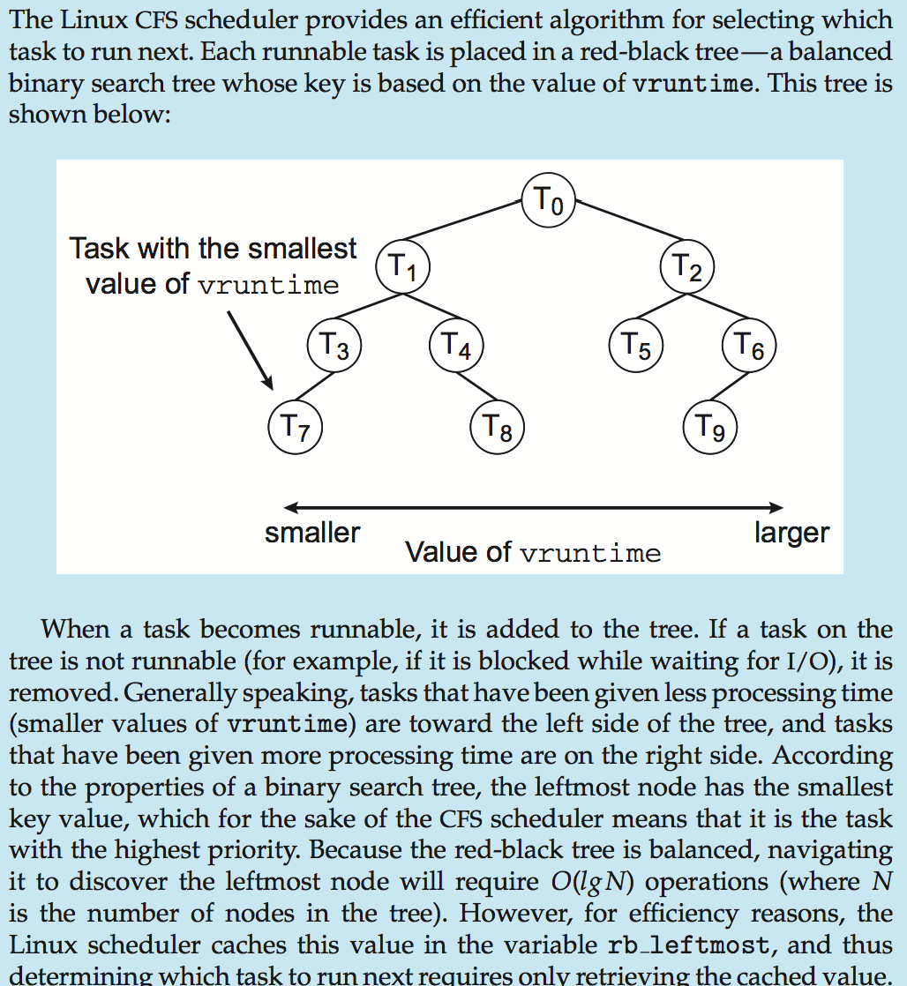
CFS Performance

Slide 77
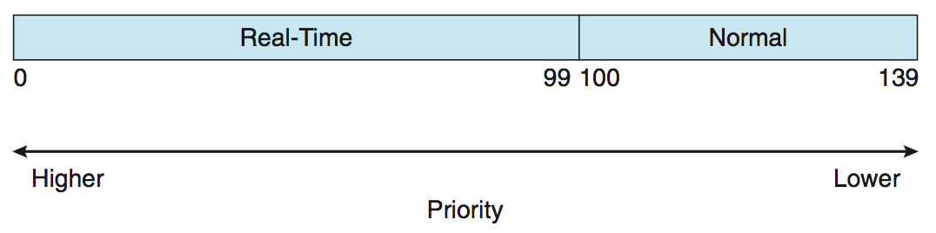
Linux Scheduling (Cont.)
Real-time scheduling according to POSIX.1b
Real-time tasks have static priorities
Real-time plus normal map into global priority scheme
Nice value of -20 maps to global priority 100
Nice value of +19 maps to priority 139

Slide 78
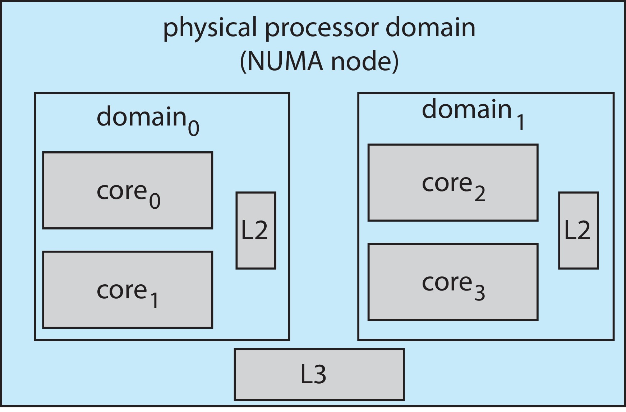
Linux Scheduling (Cont.)
Linux supports load balancing, but is also NUMA-aware.
Scheduling domain is a set of CPU cores that can be balanced against one another.
Domains are organized by what they share (i.e., cache memory.) Goal is to keep threads from migrating between domains.

Slide 79
Windows Scheduling
Windows uses priority-based preemptive scheduling
Highest-priority thread runs next
Dispatcher is scheduler
Thread runs until (1) blocks, (2) uses time slice, (3) preempted by higher-priority thread
Real-time threads can preempt non-real-time
32-level priority scheme
Variable class is 1-15, real-time class is 16-31
Priority 0 is memory-management thread
Queue for each priority
If no run-able thread, runs idle thread

Slide 80
Windows Priority Classes
Win32 API identifies several priority classes to which a process can belong
REALTIME_PRIORITY_CLASS, HIGH_PRIORITY_CLASS, ABOVE_NORMAL_PRIORITY_CLASS,NORMAL_PRIORITY_CLASS, BELOW_NORMAL_PRIORITY_CLASS, IDLE_PRIORITY_CLASS
All are variable except REALTIME
A thread within a given priority class has a relative priority
TIME_CRITICAL, HIGHEST, ABOVE_NORMAL, NORMAL, BELOW_NORMAL, LOWEST, IDLE
Priority class and relative priority combine to give numeric priority
Base priority is NORMAL within the class
If quantum expires, priority lowered, but never below base

Slide 81
Windows Priority Classes (Cont.)
If wait occurs, priority boosted depending on what was waited for
Foreground window given 3x priority boost
Windows 7 added user-mode scheduling (UMS)
Applications create and manage threads independent of kernel
For large number of threads, much more efficient
UMS schedulers come from programming language libraries like C++ Concurrent Runtime (ConcRT) framework

Slide 82
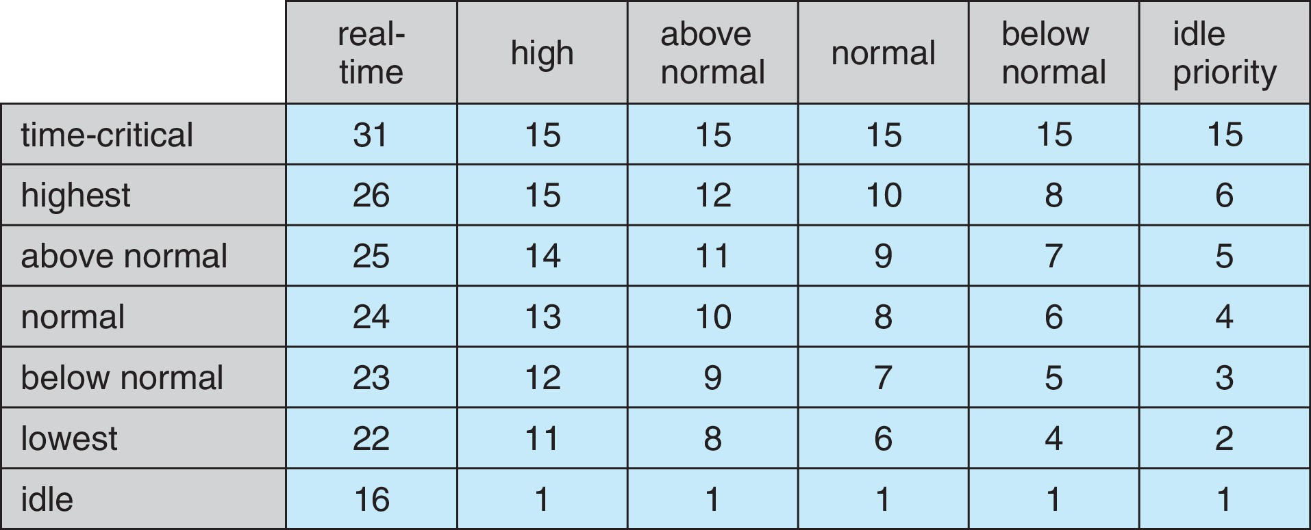
Windows Priorities

Slide 83
Solaris
Priority-based scheduling
Six classes available
Time sharing (default) (TS)
Interactive (IA)
Real time (RT)
System (SYS)
Fair Share (FSS)
Fixed priority (FP)
Given thread can be in one class at a time
Each class has its own scheduling algorithm
Time sharing is multi-level feedback queue
Loadable table configurable by sysadmin

Slide 84
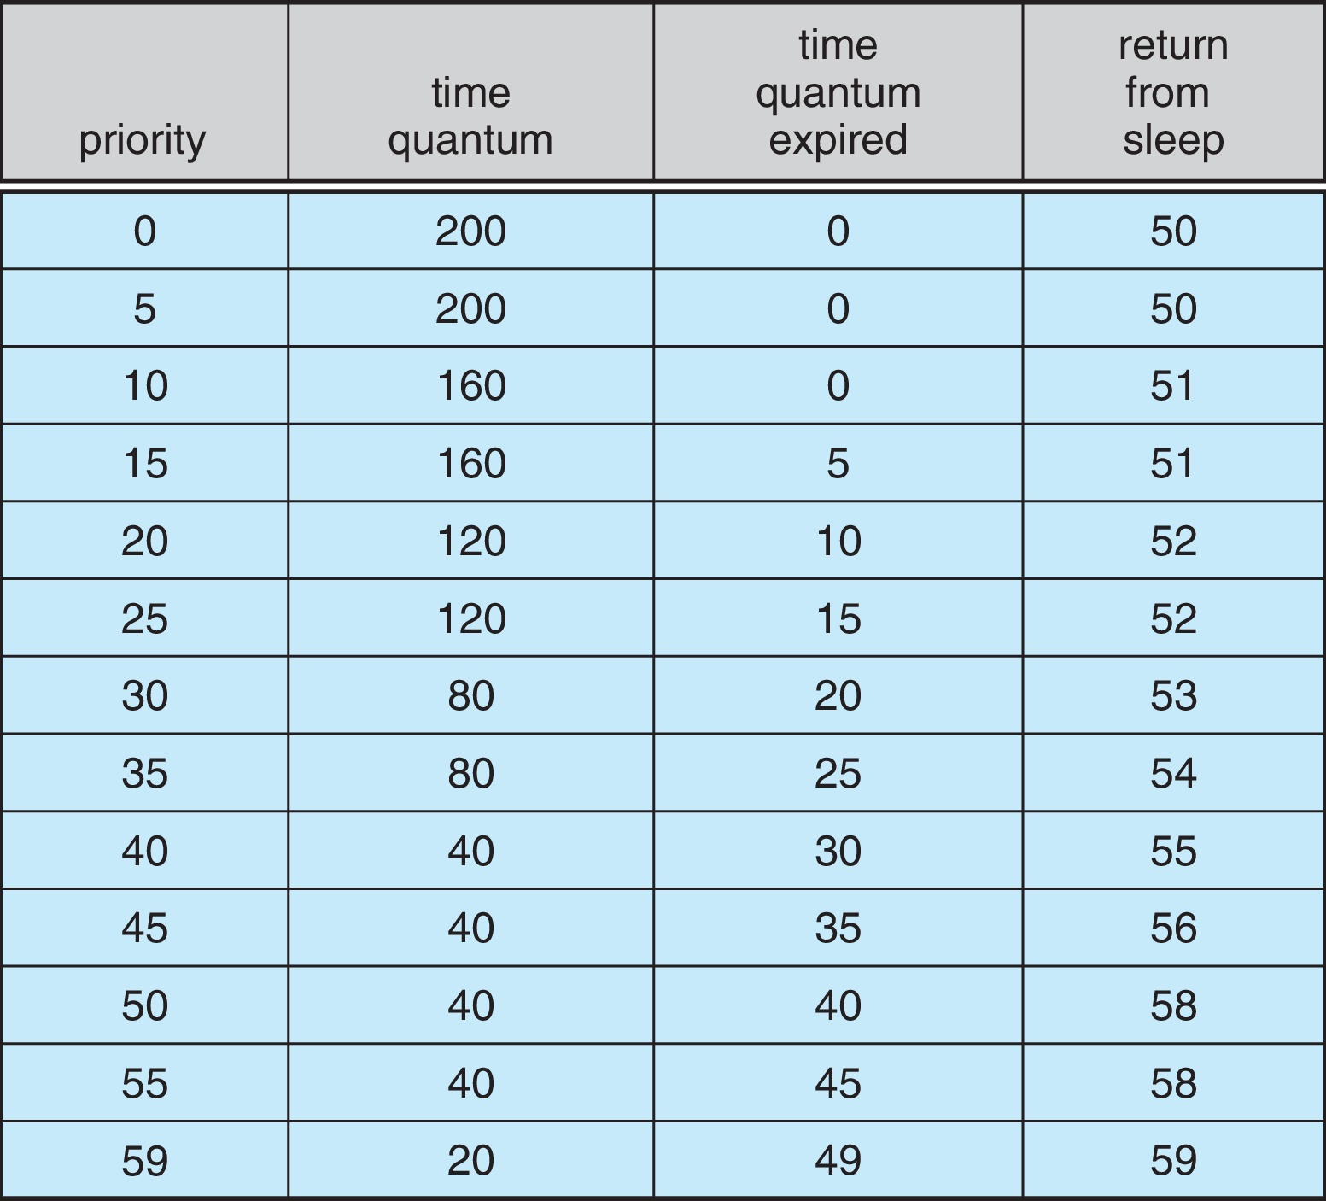
Solaris Dispatch Table

Slide 85
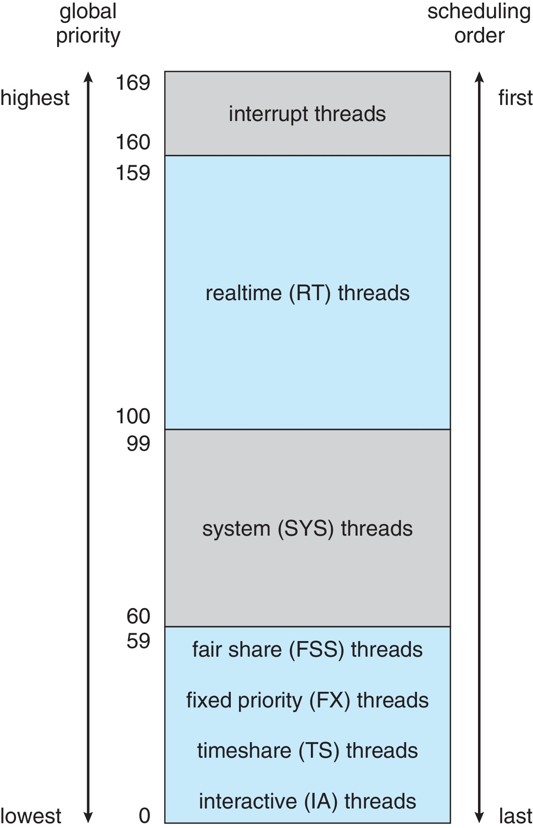
Solaris Scheduling

Slide 86
Solaris Scheduling (Cont.)
Scheduler converts class-specific priorities into a per-thread global priority
Thread with highest priority runs next
Runs until (1) blocks, (2) uses time slice, (3) preempted by higher-priority thread
Multiple threads at same priority selected via RR

Slide 87
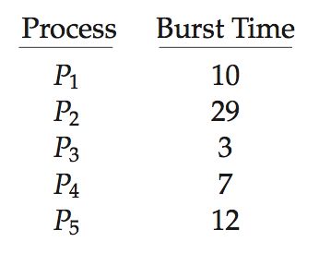
Algorithm Evaluation
How to select CPU-scheduling algorithm for an OS?
Determine criteria, then evaluate algorithms
Deterministic modeling
Type of analytic evaluation
Takes a particular predetermined workload and defines the performance of each algorithm for that workload
Consider 5 processes arriving at time 0:

Slide 88
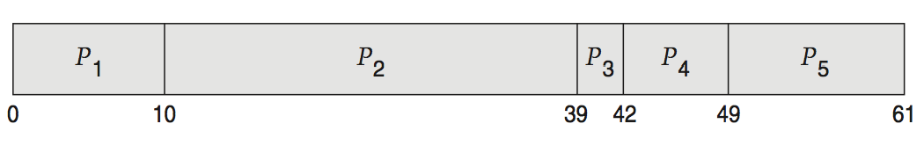
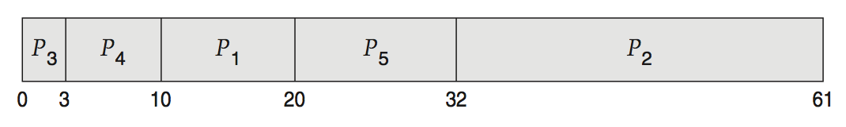
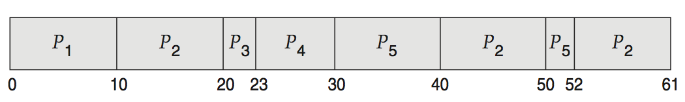
Deterministic Evaluation
For each algorithm, calculate minimum average waiting time
Simple and fast, but requires exact numbers for input, applies only to those inputs
FCS is 28ms:
Non-preemptive SFJ is 13ms:
RR is 23ms:

Slide 89
Queueing Models
Describes the arrival of processes, and CPU and I/O bursts probabilistically
Commonly exponential, and described by mean
Computes average throughput, utilization, waiting time, etc.
Computer system described as network of servers, each with queue of waiting processes
Knowing arrival rates and service rates
Computes utilization, average queue length, average wait time, etc.

Slide 90
Little’s Formula
n = average queue length
W = average waiting time in queue
λ = average arrival rate into queue
Little’s law – in steady state, processes leaving queue must equal processes arriving, thus: n = λ x W
Valid for any scheduling algorithm and arrival distribution
For example, if on average 7 processes arrive per second, and normally 14 processes in queue, then average wait time per process = 2 seconds

Slide 91
Simulations
Queueing models limited
Simulations more accurate
Programmed model of computer system
Clock is a variable
Gather statistics indicating algorithm performance
Data to drive simulation gathered via
Random number generator according to probabilities
Distributions defined mathematically or empirically
Trace tapes record sequences of real events in real systems

Slide 92
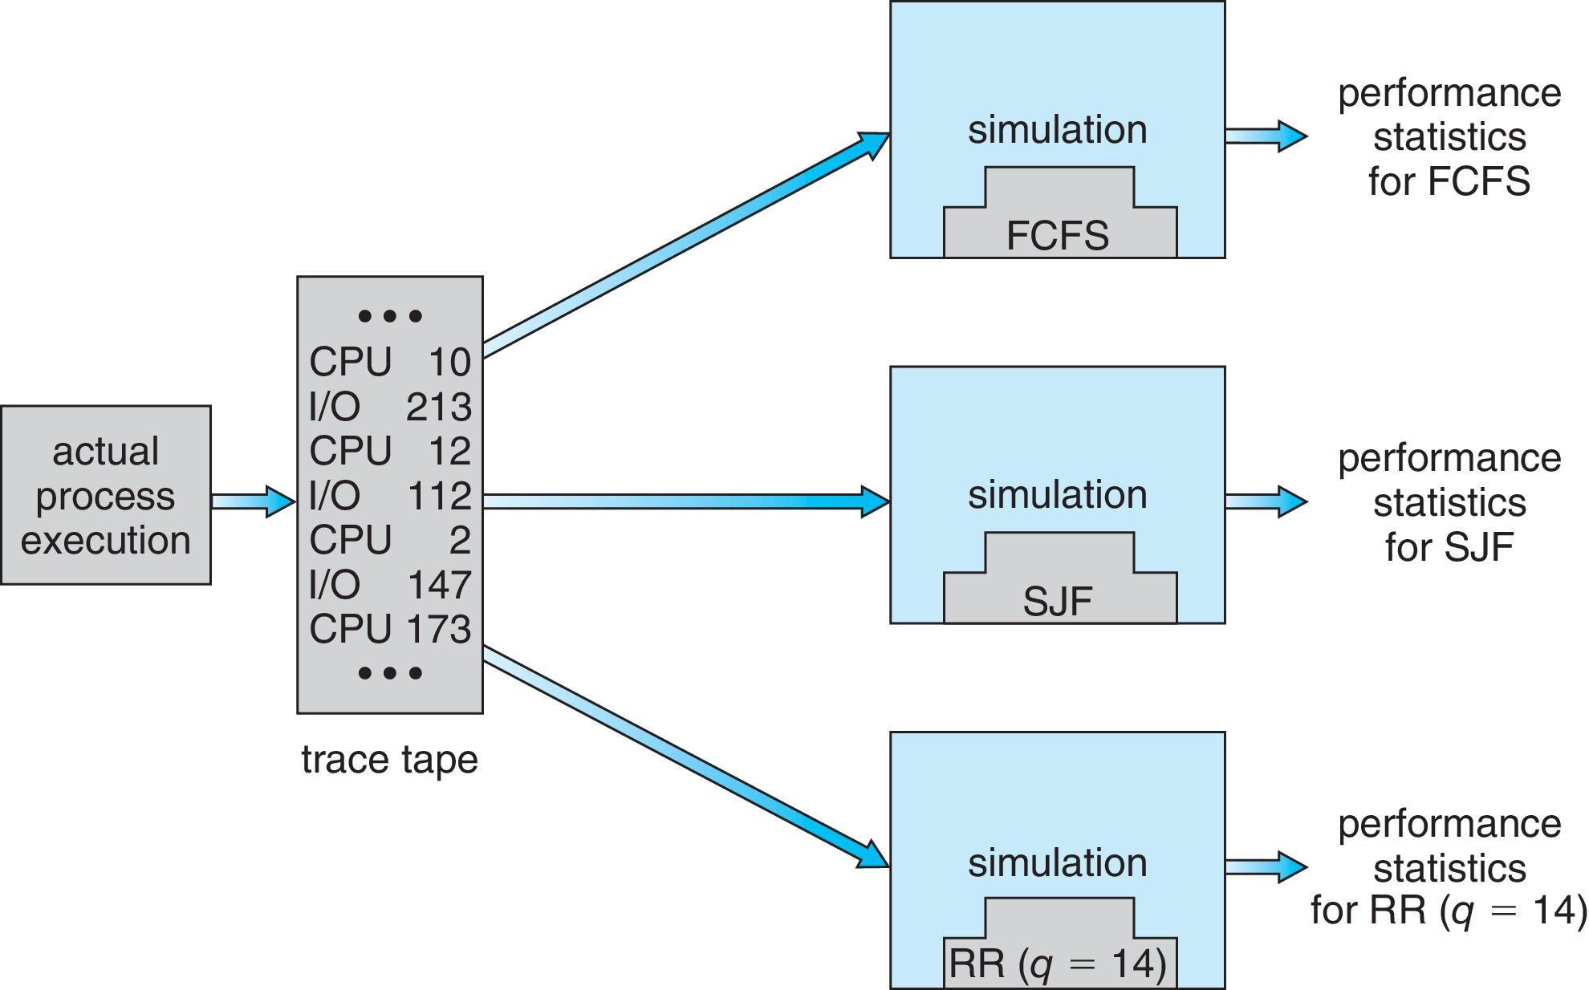
Evaluation of CPU Schedulers by Simulation

Slide 93
Implementation
Even simulations have limited accuracy
Just implement new scheduler and test in real systems
High cost, high risk
Environments vary
Most flexible schedulers can be modified per-site or per-system
Or APIs to modify priorities
But again environments vary

Slide 94
End of Chapter 5

